Slide 1
Operationalizing Infrastructure
Hands-On Challenge

Slide 2
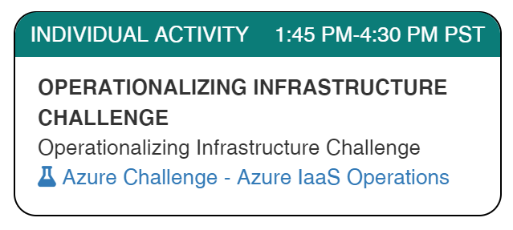
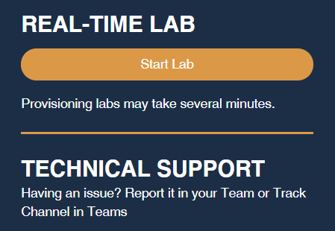
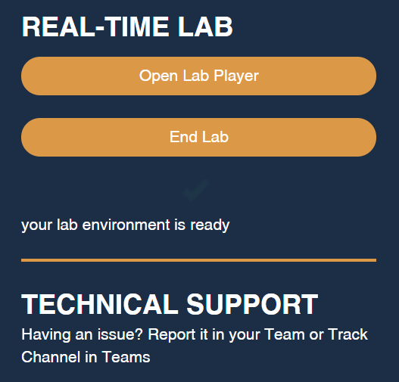
Launch the Lab Environment
Important! Allow at least 1 hour for your lab to start

Slide 3
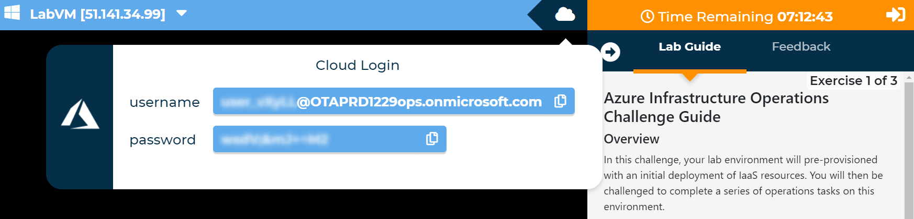
Access Your Lab
Important! Allow at least 1 hour for your lab to start

Slide 4
Challenges
Challenge 1: Automatic On-Boarding to VM Insights
Scoped to resource group (for security reasons)
Challenge 2: Resource Graph Explorer
Creating a non-trivial Resource Graph query
Challenge 3: Azure Monitor Workbooks
Explore Workbook features – feel free to do more than asked!
Note Automatic validation of your solution has been disabled to speed up the lab for you

Slide 5
Need help?
Use the Teams chat channel
Solutions will be given in tomorrow morning's kick-off session

